Slide 1

Microservices in the Wild
Katie Stockton Roberts
Notes:
Hello
I’m
How the BBC are using micro service architectures or microservices in the wild

Slide 2

About Me
Microservices in the Wild
Notes:
Worked for the BBC for coming up on 5 years - worked as a Javascript developer on IPTV (“SmartTV” ) products, such as BBC Sport, BBC News, BBC Music
I am now the Development Lead working for BBC Knowledge and Learning, where i work on products like BBC Food, BBC Bitesize, and Terrific Scientific - which is…

Slide 3
About the BBC
Microservices in the Wild
Notes:
Who are the BBC
may already be familiar with the television output Top Gear, Dr Who, Planet Earth, BBC world service, BBC Sport
BBC is advertising free, it is funded by a national TV licence scheme
We are not a commercial organisation, no sponsors
The Audience is at the Heart of everything we do
BBC has a remit to Educate, Inform and Entertain -
TV is entertain
News is inform
Knowledge and Learning is educate
Multiple locations, multiple offices in multiple locations across the United Kingdom - a big organisation 24,000 people are employed by the BBC
Around 1% (2867) of these staff working BBC Digital
BBC has had online presence since the late 90s (1997)

Slide 4
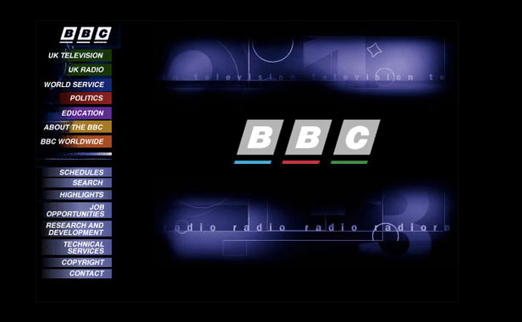
Microservices in the Wild
Notes:
And this is how the internet looked in the 1990s

Slide 5
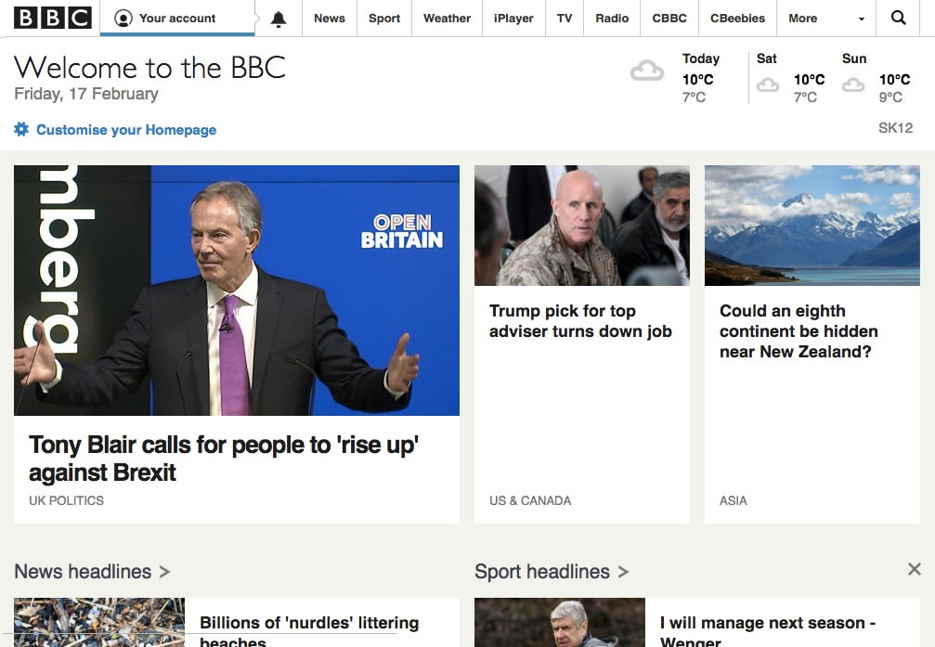
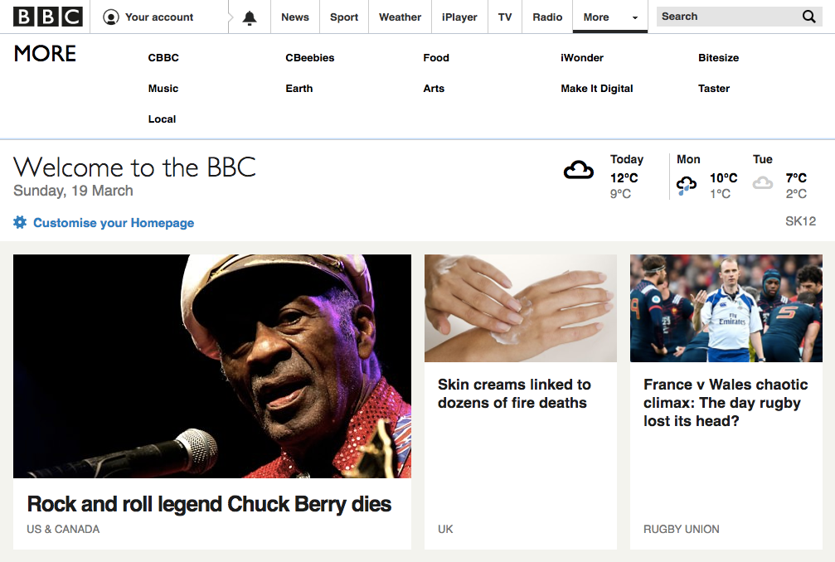
Microservices in the Wild
Notes:
How we look now
10,000 media items on line published in one week
Products across 4 screens (PC, TV, Tablet and Phone) - we support over 1000 different devices
Audience numbers - a site like BBC Food will get 3 million viewers a week, a site like BBC Sport will get close to 30 million viewers a week
BBC lots of experience in delivering content to live audiences
Many different teams divided into product areas << iPlayer, NEWS, Sport, Children’s, Radio and Music, Knowledge & Learning, personalisation, weather
Large number of development languages (Perl, MHEG, Scala, JS, Node, …)

Slide 6

Microservices in the Wild
Notes:
Microservices in the Wild
BBC are moving towards using micro service architectures
This is not a micro service - this is a micro rhinoceros
Who is the guy?
SIR David Attenborough - a national treasure

Slide 7
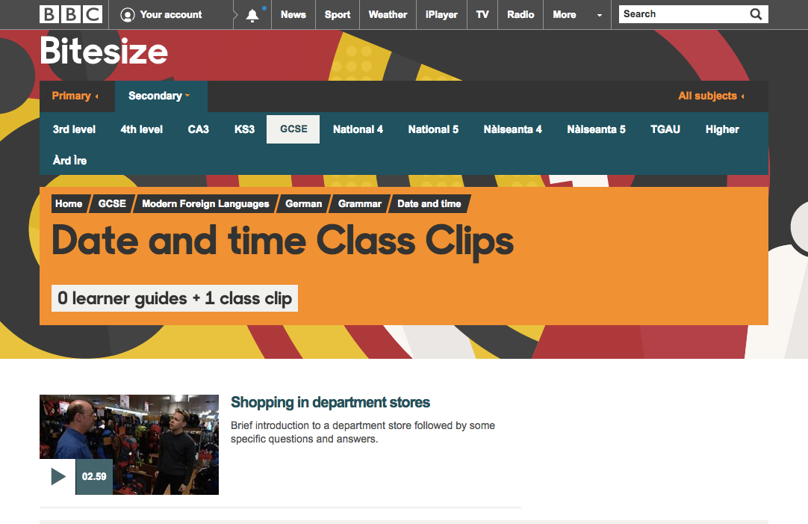
Microservices in the Wild
Notes:
What is Bitesize -
educational tool
for children 4-16
to support them and their teachers throughout their school years.
First launched in 1998
in current form around 10 years old
Bitesize covers:
The separate educational systems of all 4 nations
in 38 subject areas (300 separate programmes of study)
5,000+ topics of study
Over 5,000 Revision Guides
82% of 15-16 year old exam students in the UK say they use BBC Bitesize
we pull in around 3m UK UU around the exams

Slide 8

Microservices in the Wild
Notes:
Its also a bit of a monolith
It is not a new code base (some code in there goes back to around 2010) written in PHP
difficult to add new features
regression testing is very long winded,
release process, tickets raised with rpms for releases needed to stage and live
because process is long winded, problem of it taking weeks to implement a one line change.
As a developer this is not a fun place to be
Reduces developer capacity
single monolithic codebases do not necessarily scale to large numbers of users
So let’s take a look at the monolith

Slide 9
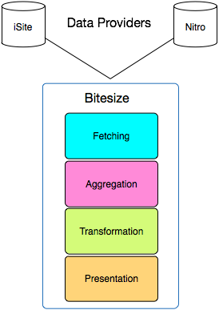
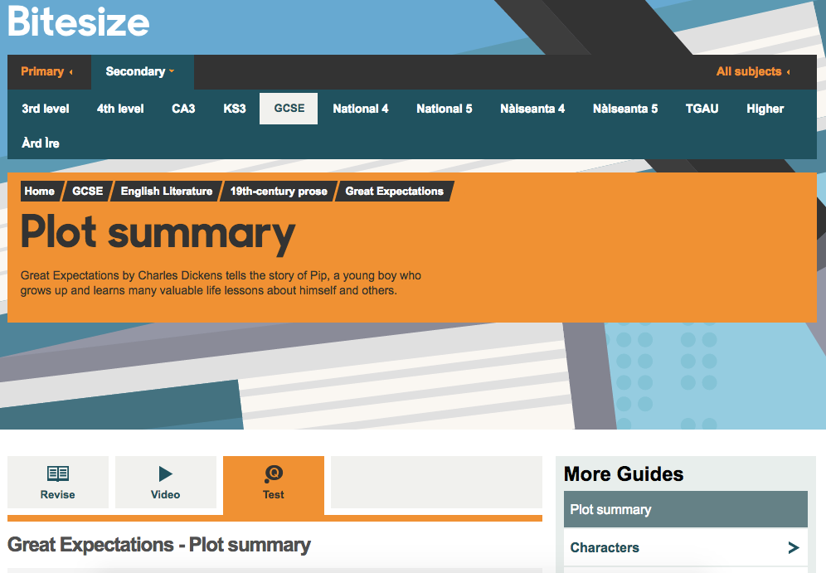
Bitesize website
Microservices in the Wild
Notes:
standard N-Tier architecture
written in PHP
iSite is our Content Management System - where the Editorial team write the content
Nitro the API where we get our media playback information
data driven website

Slide 10
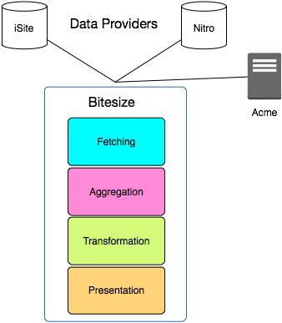
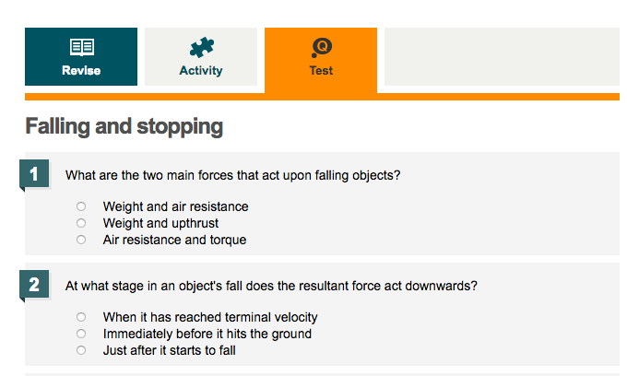
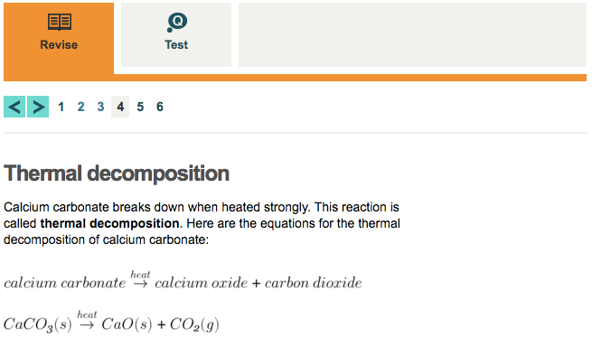
Bitesize website
Microservices in the Wild
Notes:
It also uses ACME - our games management service - Bitesize uses this for quizzes and mock exam questions.
shared with other BBC teams (Children’s BBC uses them too), so this is a monolith in itself
Around 2012 the Bitesize team started to move towards a microservices architecture - breaking away components and content that could be seen as isolated functionality.
Where to start with micro service architecture
identify a problem and solve it outside the monolith
Bitesize has some unique problems which it has to solve, Equations and Formula especially for in Maths and Science subjects
use LaTeX format
tried online equation editors -
no existing package for long maths or long division
iSite and online systems unrelated

Slide 11
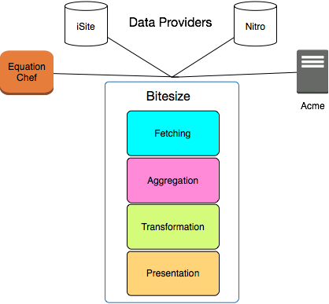
Bitesize website
Microservices in the Wild
Notes:
Created a micro service on AWS - Equation Chef a service that renders equations for LaTeX strings.
The system works by
sending requests to Latex packages
which create a pdf containing the formula,
which is in turn converted into a '.png' with a transparent background
which is rendered on the website front-end Bitesize App via iSite.

Slide 12
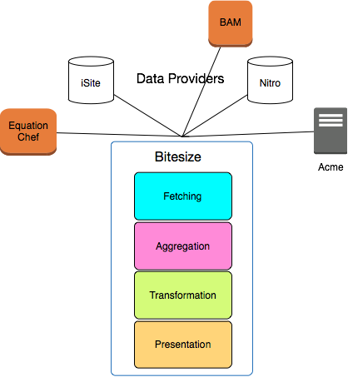
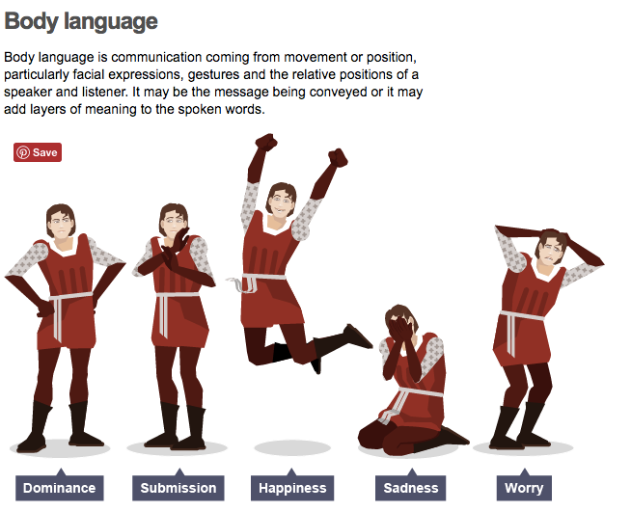
Bitesize website
Microservices in the Wild
Notes:
Another problem was our CMS (iSite) did not really have the capabilities and functionalities that the Editorial teams required to upload and use of assets such as infographics.
so the team built another micro service to allow them to upload binary assets (such as this infographic) to S3 buckets, which is then made available to Bitesize to render into on the Bitesize site.
and the team called it BAM

Slide 13
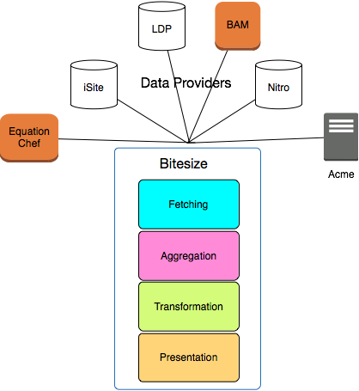
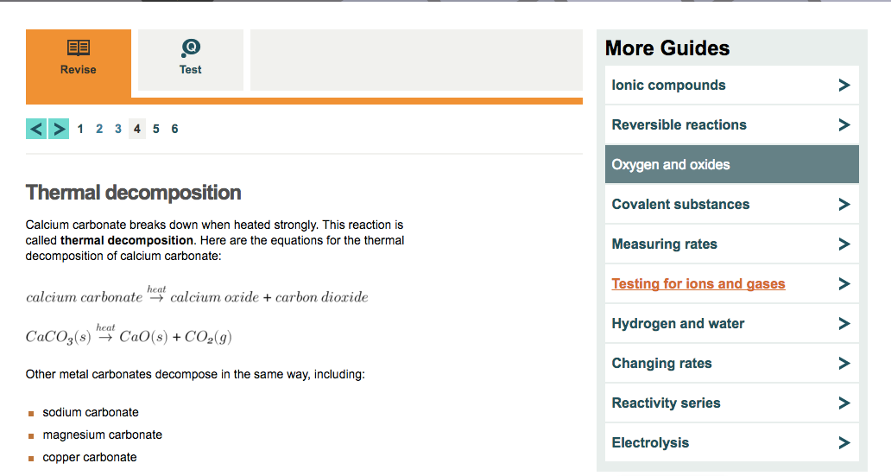
Bitesize website
Microservices in the Wild
Notes:
The Linked Data Platform (LDP) is a BBC wide data management system which enriches the Bitesize Content still further by linking the topics of study relevant to what the user is viewing
Modelled the national curriculum structure - programmes of study and topics of study, which is really important because the curriculum regularly changes
Still got an N-Tier architecture - but slightly less cluttered with functionality

Slide 14
If it ain’t broke …
Microservices in the Wild
Notes:
But main body of Bitesize works -why would we even thinking about changing it?
Audience feedback - bitesize is difficult to find relevant content to what I need to know
No way of mapping content to different exam boards

Slide 15
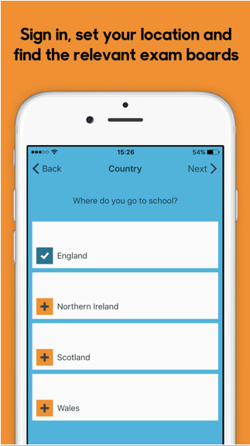

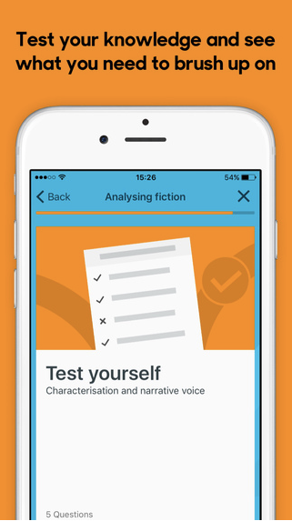
Bitesize App
Microservices in the Wild
Notes:
Requirements
As an exam student I want to be able to
Personalise Bitesize content to to my needs
To be able choose my country, language, and exams
To have Bitesize content in a shorter form - easier to digest for exams
Test myself on what i have learnt to see how well i am revising
Or from a tech perspective

Slide 16
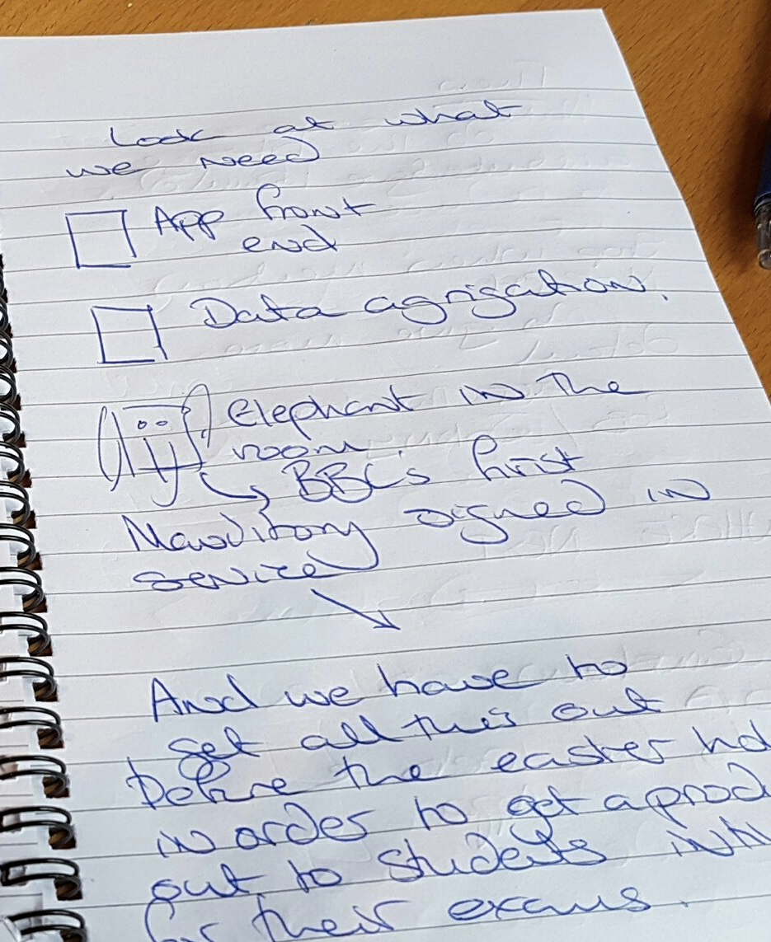
Microservices in the Wild
Notes:
Or in tech speak
iOs and Android front end apps
Data aggregation layer
Highly personalised === Mandatory sign in
Why do we have deadline - has to fit in with the schools exam period
4 months to build, all these things have to be built in parallel

Slide 17
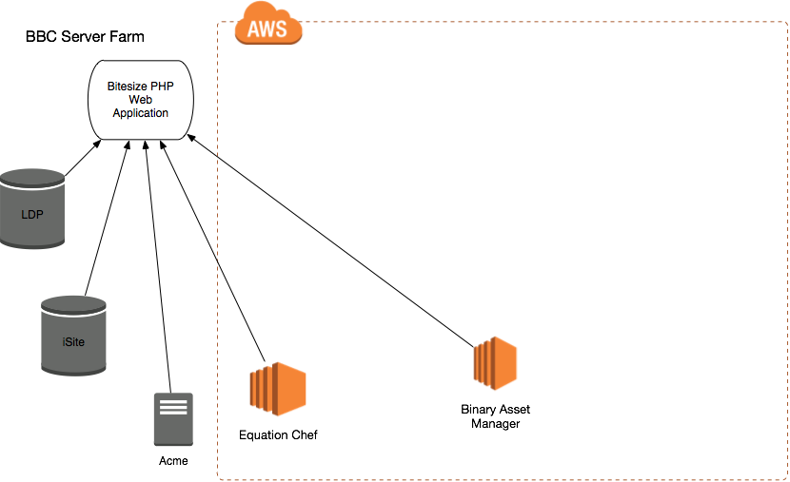
Microservices in the Wild
Notes:
Here is our Bitesize PHP web Application
It is housed on What is forge - the BBC internal server farm
AWS some products have already been moved as microservices

Slide 18
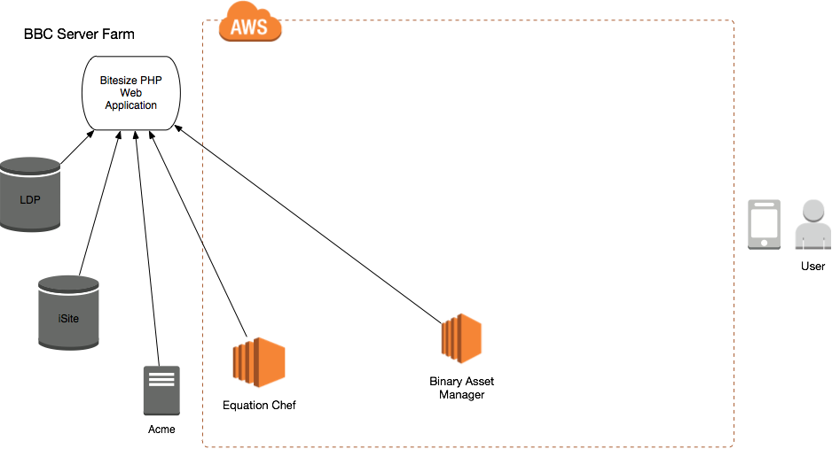
Microservices in the Wild
Notes:
Our mobile user
Mobile can’t hope to process the data in the same way
reimplement the business logic for Bitesize in not only PHP (which the Bitesize Website is built using) but also Objective-C (for iOS) and Java (for Android).
increased complexity massively, and probably app size
Multiple data calls - not great when you are a student paying for 3G connectivity

Slide 19
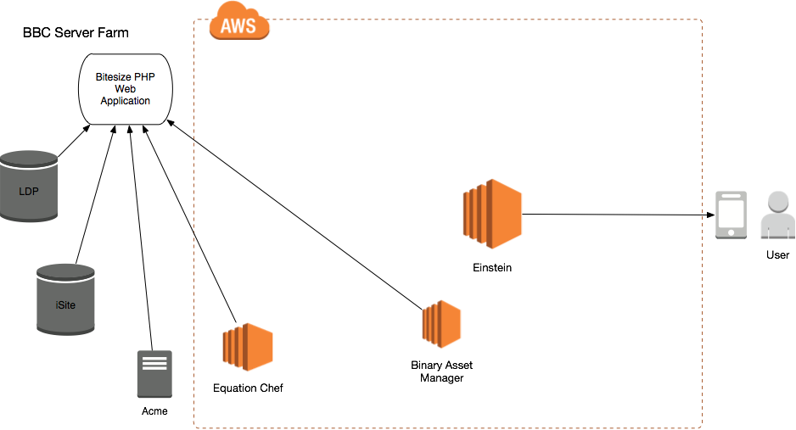
Microservices in the Wild
Notes:
So to power the data for the app we created Einstein - a node microservice - which is powering the content of the app

Slide 20
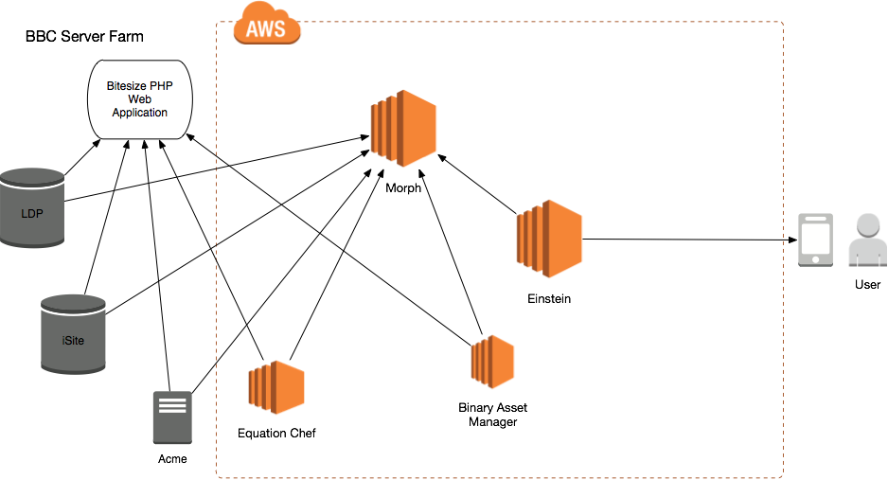
Microservices in the Wild
Notes:
Using MORPH

Slide 21


What is Morph?
Microservices in the Wild
Notes:
a BBC produced, node, cloud based system which fetches data from other data sources, runs operations on that raw data, then makes the output of those operations available for consumption.
allows the aggregation of data from multiple sources
plus we get Caching benefits
(Morph is also a Children’s BBC character from the 1970’s) > benefit of working at the BBC - we have lots of things to name our services after

Slide 22

Microservices in the Wild
Notes:
Einstein is not just a pass through for Morph -
helps with versioning of the content so we are delivering the appropriate content to the App,
handles error processing
generates appropriately formatted error response
Next personalisation….

Slide 23
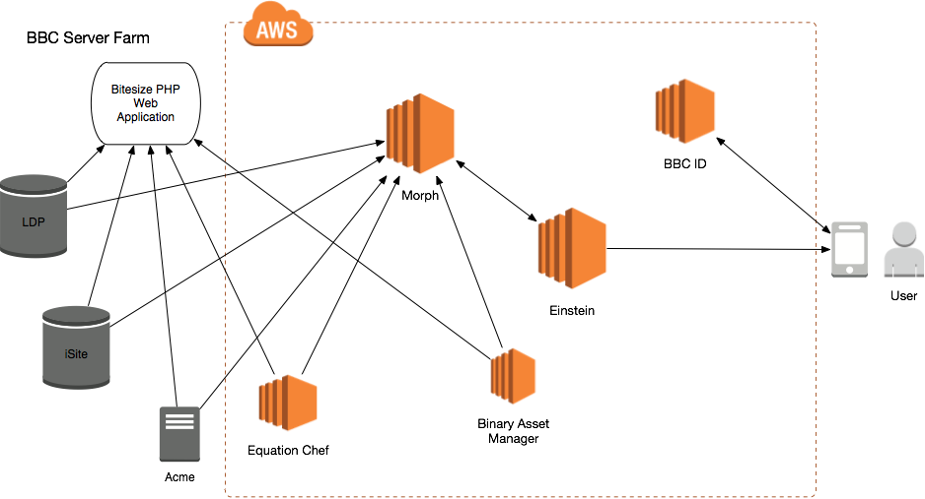
Microservices in the Wild
Notes:
Luckily we have a sign in service at the BBC which allows us to do this - so we use this to manage our users credentials

Slide 24
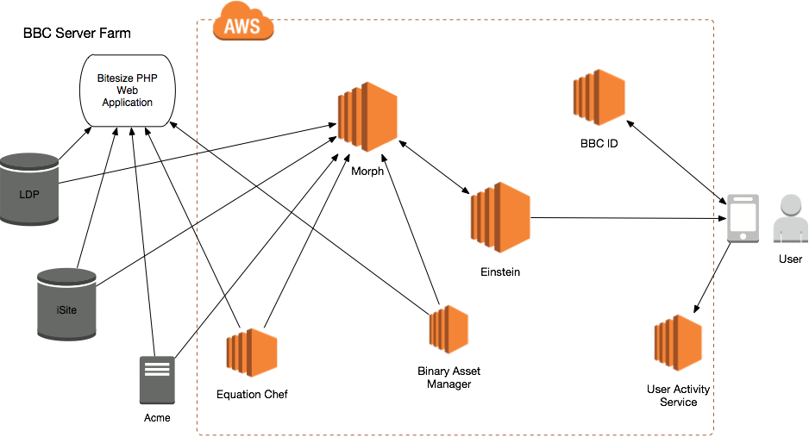
Microservices in the Wild
Notes:
We now need to be able to store our users preferences - again we have a service we can use for this - User Activity Service
Problem with the Users Activity service - doesn't store the full content - just (shorter codes for content) so as not to bloat its size

Slide 25
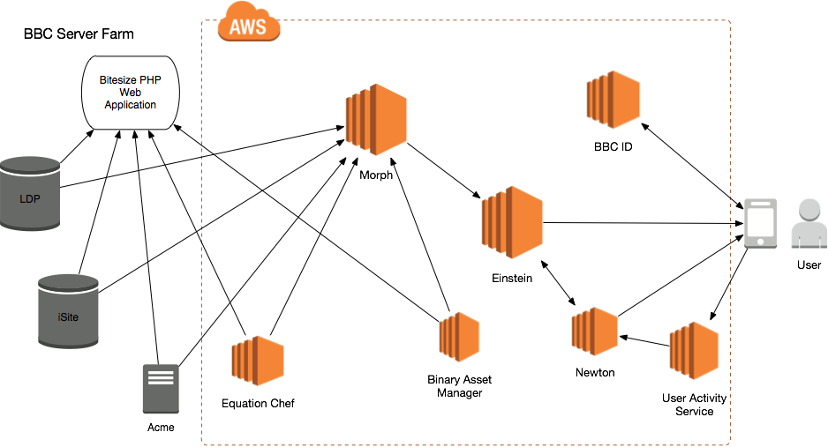
Microservices in the Wild
Notes:
Newton, another Node service —
takes content from UAS and rehydrates it with data from Einstein
providing the app with digestible, personalised, data that it can use
Testable in isolation
AWS services can scale up individually as and when needed - which is important - we need to have high availability - importance of not 500ing during exam time!
So where can we go from here? Could we take the data aggregation out and using what we have already built?

Slide 26
Bitesize website
Microservices in the Wild
Notes:
Moving from our n-tier Monolith to a more micro service based architecture

Slide 27
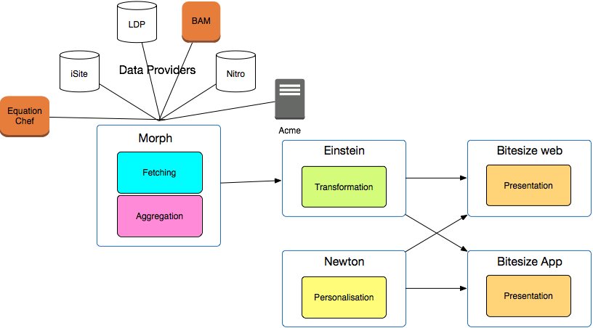
Bitesize website
Microservices in the Wild
Notes:
What are the benefits of doing this?
Make changes which are transparent to our audience -
Now just a presentation layer it is easier improve our product
simplify the code means it becomes easier to add new features

Slide 28
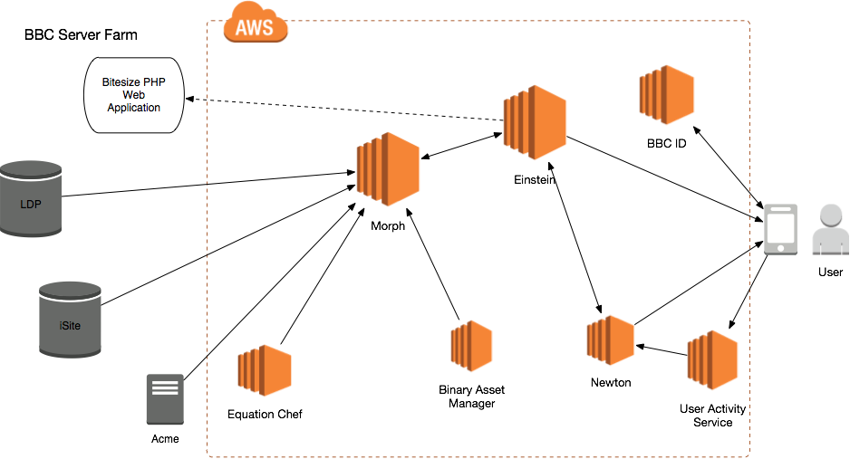
Microservices in the Wild
Notes:
What we could do is use Einstein to power the presentation layer - but then Einstein is in danger of taking on too much responsibility again, it is no longer just for the Bitesize app

Slide 29
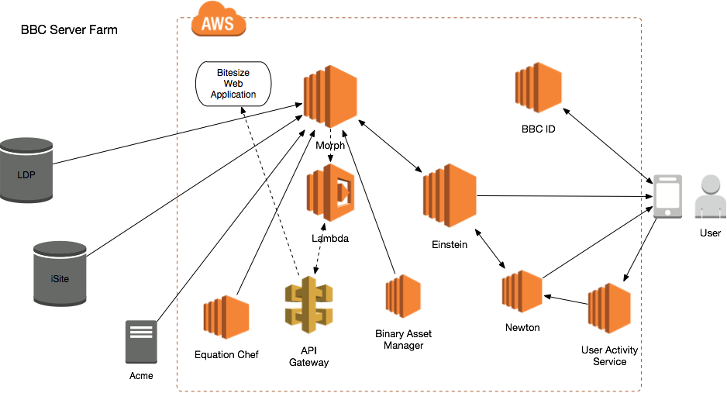
Microservices in the Wild
Notes:
What we are actually doing currently is moving in a direction that looks a little more like this or more accurately …

Slide 30
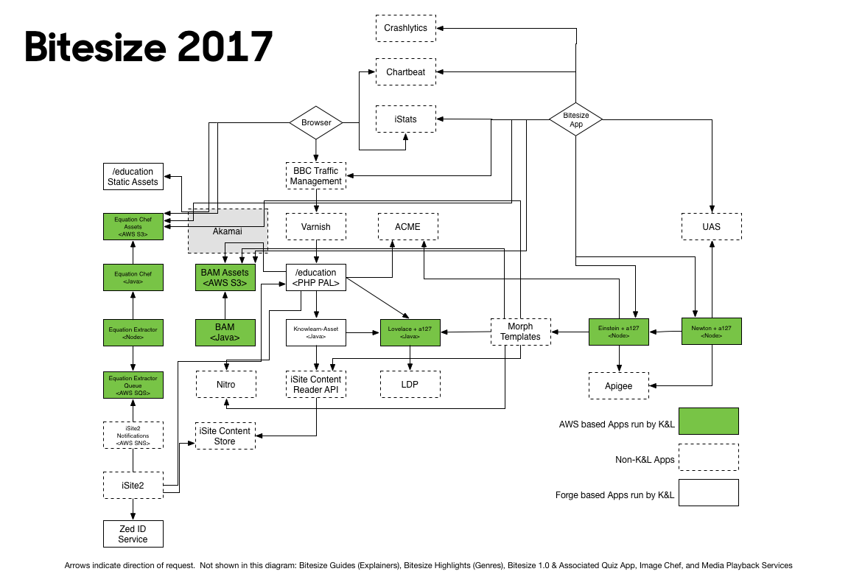
Microservices in the Wild
Notes:
Although it is not quite that simple - this is the actual architecture diagram for the current bitesize build !
But the point is we are simplifying - the previous diagram had less boxes and more internal complexity

Slide 31
Team Size
Microservices in the Wild
Notes:
at a conference - “of course the bbc can do this - you have hundreds of developers”
Not necessarily true
we have small development teams Knowledge and learning has a total of 14 developers
For the build of Newton and Einstein we had a feature crew of
3 developers
1 dedicated tester
1 Business Analyst
1 Product owner
can be shared resources
1 PM
plus support from Dev lead, Test lead

Slide 32

Notes:
So lets do a bit of summing up - what is good about microservices
faster development
built and deployed independently
Allowed products to evolve at their own pace
we release little and often - isolating changes to allow for quick identification and resolution of problems
simplified testing of products - when the team tests Newton - they are testing that product only
We run a zero bug backlog
Well tested 60% of development time is spent writing tests (unit, behaviour, integration tests)
Allowed products to be developed in a language that is appropriate to what they do (Lovelace is in Java)
Black box APIs for other teams that might want to integrate within the BBC who may want to integrate with our services

Slide 33
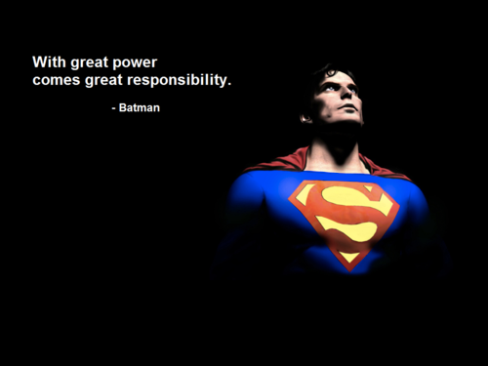
Microservices in the Wild
Notes:
Moving to a microservices model is not without problems
we are a dev ops team - we build, we support and we build a lot so now we have to support a lot
web developers now are expected to be full stack developers - we have had to become System Administrators
have to learn more than one system - and expected to be an expert in all of them
Cost - ASW costs, the cost of our internal server farm was invisible
Security - problem of api key into github? IAM roles being too permissive
micro services setting up infrastructure many times
Monitoring - we need to closely monitor all our services and we are on call 24/7.
Responsible for all our products - But - that creates a mindset that allows us to build more robust systems and services
Santosh’s comments about the slide - my love of comics
“for me, the short stories are the places where I get to fly, to experiment, to play. I get to make mistakes and to go on small adventures” - Neil Gainman
Microservices are a bit like that - we build fast - we can fail fast - we can craft what we need when we need it
moving to a micro service architecture has been beneficial to our team
not without some difficulties
not rocket science

Slide 34
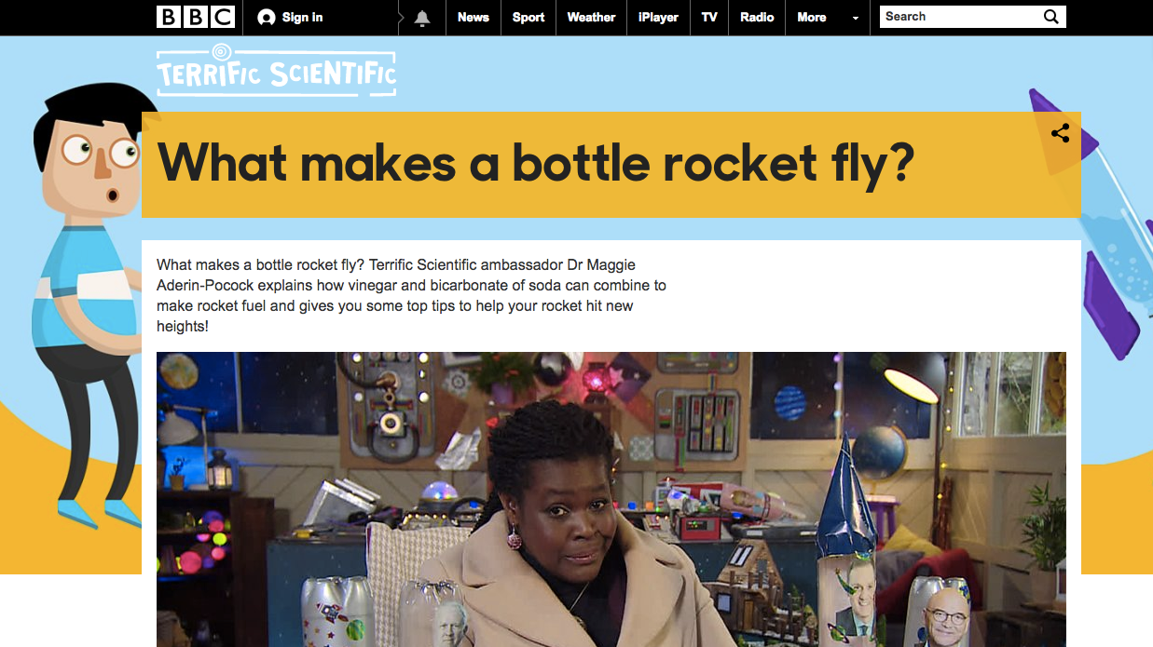
Microservices in the Wild
Notes:
But if you do want to lear about Rocket Science we have a page for that http://www.bbc.co.uk/guides/z8hy97h

Slide 35
Thanks
@moogster31

